Slide 1
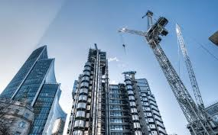
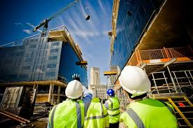
IMPORTANCE OF CONSTRUCTION SECTOR FOR ECONOMIC DEVELOPMENT IN SRI LANKA & ROLE OF ACCREDITATION
By: Prof. Chitra Weddikkara
Chartered Architect /Chartered Quantity Surveyor/ Project Manager /Adjudicator
FRICS FAIQS FIQSSL FIPMSL
A ARB RAIA FIASL

Slide 2
Significance of the construction Industry
Construction industry is complex and highly competitive in nature when comparing to other industries
It is a major industry throughout the world accounting for a substantial proportion of most countries’ national economy and defined as the creation of physical facilities that are needed in the development of other productive activities
Construction's direct contributions to development are significant; it also stimulates a sizeable amount of economic growth through backward and forward linkages
As a developing country, Construction industry again plays a vital role in Sri Lankan Economy and also important in terms of satisfying basic physical and social needs of the country

Slide 3
Economic Growth & Construction industry
Economic growth is ‘an increase in the amount of goods and services produced per head of the population over a period of time’
Economic growth can be basically measured by Gross Domestic Product (GDP) and Gross National Product (GNP)
Since the construction industry is always been closely related to the national economy, for a developing country like Sri Lanka, as it is essential to have rapid economic growth there should be a rapid expansion of construction investments

Slide 4
Sri Lankan Construction Industry -Stakeholders
The major participants of the construction industry:
-Clients (Owners, Operators, and users of the constructed facility)
-Consultants (Architects, Engineers, Management consultants)
-Contractors (General contractors, Special trade contractors or subcontractors)
Building finance and insurance agencies, land developers, real estate brokers, and material and equipment suppliers and manufacturers, are also involved in construction but are generally considered as external from the construction project
The government interacts with the industry as purchaser, financier, regulator, and adjudicator

Slide 5
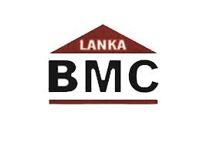
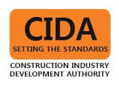
Sri Lankan Construction Industry
Major Government authorities involved in construction industry and their involvement to national Economy
(1) The MHC (Ministry of Housing & Construction)
Regulation of construction sector
Conducting research and development activities
Training and developing those involved in the construction sector
Providing engineering services to public sector institutions
Housing development, development of underserved settlements, community empowerment and regulatory activities pertaining to the condominium sector
Affiliated with a variety of other federal-level authorities,
Construction Industry Development Authority (CIDA)
State Engineering Corporation
State Development and Construction Corporation
Building Materials Corporation

Slide 6
Sri Lankan Construction Industry
(2) Urban Development Authority (UDA)
Empowered to undertake;
Capital investment plans in urban areas
Develop and implement land use policy
Formulate and enforce environmental standards and improvement policies,
Carry out work related to the development of urban infrastructure
Undertake housing schemes of any size
UDA works alongside the MHC, the newly incorporated Ministry of Mega polis and Western Region Development, and other entities in many of these areas

Slide 7
Sri Lankan Construction Industry -Statistics
According to the Department of Census an Statistics; as of 2012, the total estimated value of all types of construction activity in Sri Lanka was LKR 113.43bn ($816.7m)
Buildings, or structures, make up LKR 58bn ($417.6m) of work done in 2012, which was equal to 51.1% of total work
In second place was highways, on which LKR 30.4bn ($218.9m) was spent over the course of the year, or 26.8% of the total
According to the National Development Bank (NDBS), in 2014 the construction sector accounted for 9.6% of Sri Lanka’s GDP

Slide 8
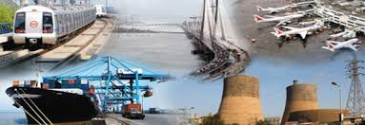
Sri Lankan Construction Industry-Major Projects
Infrastructure Projects
Under a range of short- and medium-term master plans, the government has invested heavily in infrastructure of all kinds in recent years
The Ministry of Transport and the Ministry of Higher Education and Highways, for example, have carried out a considerable amount of road and expressway development and refurbishment in recent years
Nearly ,94% of the population had access to improved drinking water as of 2012,44% of this water was delivered directly to homes via pipes as of 2014
Colombo Port City project
Moragahakanda power project

Slide 9
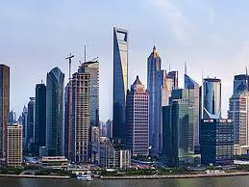
Sri Lankan Construction Industry-Major Projects
Building Projects
Various real estate segments were in demand as of early 2016, including grade-A office space, hotels, affordable and luxury residential space and commercial space
Key projects in this space include large-scale mixed-use commercial, residential and hotel projects currently being developed by Hyatt Regency, Shangri-La Hotels and Resorts, and Moovenpick Hotels and Resorts

Slide 10
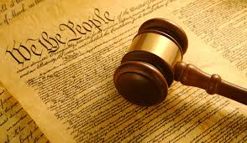
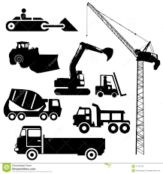
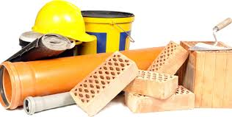
State Announcements
To reduce import duties on a range of:
Materials
and Machinery
Government Training under their Cost for:
carpenters
plumbers
electricians
and other related workers

Slide 11
Government Implementation in Constructions’ Cost Input
Lowering or cancelling import duties on a variety of products
Reducing price of Bulk Cement, one of the major materials use in the country (70% of Dry Bulk Cement mainly imported from India). As of mid-2015 the nation’s cement capacity was 7.5m tonnes, according to industry data supplied by a local cement producer
According to Asia Securities, a Colombo-based equities brokerage, in 2016-17 the state plans to spend around LKR 590bn ($4.2bn), primarily on road and other types of infrastructure projects

Slide 12
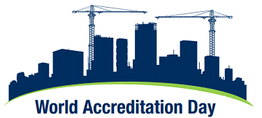
Accreditation -Delivering confidence in the construction and the built Environment
9th of June 2017 celebrated the World Accreditation Day
It was a global initiative to raise awareness of the importance of accreditation. It has been jointly established by the International Accreditation Forum (IAF) and the International Laboratory Accreditation Cooperation (ILAC)
This year’s theme focuses on construction sector and how accreditation can support professionals in the construction industry, ranging from designers, architects, civil engineers, contractors, manufacturers, to regulators

Slide 13
Construction Sector Accreditation
The construction sector is complex and highly competitive, and provides challenges for companies seeking to improve margins, and reduce costs whilst improving build quality and ensuring a safe environment on site
Accreditation supports the construction sector to control risk, help drive efficiency, help regulatory compliance, and provide supply chain confidence
Standards and accredited conformity assessment are market-based tools that can be used in the construction sector to cover construction related academic programs, products and materials, building techniques and practices, onsite Health & Safety, environmental impact, to even the use of digital technology in smart buildings

Slide 14
Construction Sector Accreditation
Construction sector Accreditation is divided into two areas:
Accreditation of academic courses in the construction sector such as Architecture, Engineering and Quantity surveying to name few at the Technical level, undergraduate level and post graduate level
Accreditation of products and materials, building techniques that are being manufactured and supplied to the building sector
The type of Accreditation bodies for Academic programs carried out by local Professional institutes are the Sri-Lanka Institute of Architects, (SLIA) Institute of Engineers ,(IESL) Institute of Quantity surveyors (IQSSL) Further Practice of Architecture is accredited by Architects Registration Board (ARB)
The international accreditation bodies are Royal institute of British Architects (RIBA) the Royal Institution of Chartered Surveyors (RICS) Australian Institute of Quantity surveyors AIQS) Charted institute of Builders (CIOB) are some of the familiar accreditation bodies for the courses in Architecture and Quantity surveying

Slide 15
What is the role of Accreditation??
Accreditation determines the technical competence, integrity and impartiality of organizations providing conformity assessment services for academic degrees professions and in terms of products such as testing, calibration, certification, and inspection based on international standards
Accreditation is meant as an impartial and objective process that provides the least duplicative, the most transparent and the most widely accepted route for the provision of credible and trustworthy conformity assessment results

Slide 16
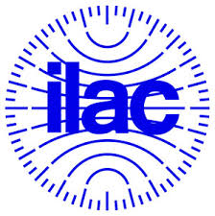
What is the role of Accreditation??
Accreditation bodies are established in most countries to ensure that conformity assessment are carried out by a competent body
Internationally recognized accreditation bodies, which have been evaluated by peers as competent, sign international arrangements that enhance the acceptance of academic degrees professionals, products and services across borders, thereby creating a global infrastructure to support trade regulatory approval processes, and confidence in the marketplace
Some of these arrangements are managed by IAF, in the fields covering accreditation of certification bodies and verification/validation bodies, and ILAC, in the areas of laboratory and inspection body accreditation

Slide 17
What are the issues ??
Are the buildings we live or work is safe?
Are there measures in place to ensure that construction sites are safe places to work?
What reassurance is there that raw materials and construction products meet specification and are of suitable quality?
How do we know that buildings are capable of withstanding fire, storm, water, collapse, subsidence, vibration?
How can we trust claims made about the environmental impact and sustainability of construction projects?
Are the academic programs conducted in construction related services are of good quality and standards ?
Is there fairness in the accreditation courses by the institutions?
Is there biasness personal agendas against giving accreditation by the professional bodies ?

Slide 18
Benefits of Accreditation in General
This system helps to make work carried out by accreditation bodies consistent across the globe, and maintains international standards from one accreditation body to others
As a result, products and services tested, inspected or certified under the IAF and ILAC umbrella can be accepted everywhere with equal confidence
Accreditation is a well-established process that can demonstrate that organizations are compliant with their regulatory responsibilities
Academic programs when accredited become quality program suitable to the construction sector in terms of quality and competency
It maintain industry standards consistent with world accreditation bodies

Slide 19
Benefits for Construction Companies and Manufacturers of Construction Products
Confidence that manufactured products and raw materials are safe and meet specification, thereby reducing potential delays, product failure, and project costs
Reliable measurements, tests and inspections are carried out in compliance with best practices to limit product failure, reduce down time and control manufacturing costs
Accreditation ensures that they can make an informed choice and have confidence in their selection of suppliers
Using an accredited body to carry out an independent evaluation helps demonstrate due diligence in the event of legal action
Accreditation to internationally-recognized standards can provide a competitive advantage and facilitate access to export

Slide 20
Bibliography
Ramachandra, T. and Raufdeen, R. (2006) Study of the relationship between construction sector and the Sri Lankan economy, 6(2), 50-55
Oxford Business Group (2016) Sri Lanka’s construction sector sees increased investment and development
LAC mutual recognition arrangement (ILAC MRA) and a list of Accreditation Body Signatories is available on the ILAC website http://ilac.org/ilac-mra-and-signatorie
Central Bank Report, 2012
National Development Bank Report, 2014

